Slide 1
Magic the Gathering Card Scanner
Klayton, Radeeb, Sam, TJ, and Zach

Slide 2
What is Magic the Gathering
Magic is a trading card game
Originally published in 1993
One of the most popular trading card games in the world

Slide 3
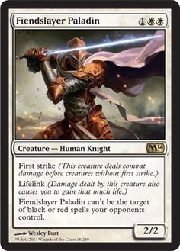
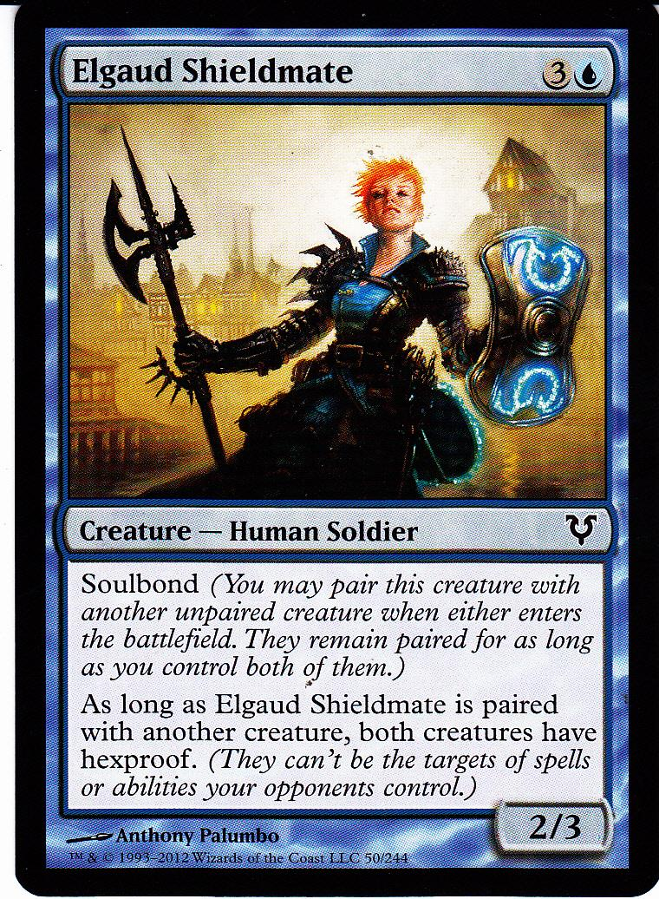
Magic the Gathering Cards

Slide 4
Name of the card

Slide 5
Cost of the Card

Slide 6
Type of the Card

Slide 7
Set and Rarity of the Card

Slide 8
Description for the Card

Slide 9
Attack and Defense of the Card

Slide 10
Image for the Card

